Slide 1
Plotting aesthetics
DO NOT PANIC!!
This is just a record of what can be done
No need to look closely, just know it can be done
Refer back to this code when you need to do it

Slide 2
Preparing required datasets and objects for this section
#Preparing required datasets and objects
data(mtcars)
data(diamonds)
mtcars$f.gear=as.factor(mtcars$gear)
mtcars2=data.frame(
f.gear=as.factor(levels(mtcars$f.gear)),
meanDrat=c(mean(mtcars[mtcars$f.gear=="3",5]), mean(mtcars[mtcars$f.gear==4,5]),mean(mtcars[mtcars$f.gear==5,5])),
sdDrat=c(sd(mtcars[mtcars$f.gear=="3",5]), sd(mtcars[mtcars$f.gear==4,5]),sd(mtcars[mtcars$f.gear==5,5]))
)
d=ggplot(mtcars,aes(x=f.gear,y=drat))
e=ggplot(mtcars2,aes(x=f.gear,y=meanDrat,group=1))
f=ggplot(mtcars,aes(x=wt,y=drat))
g=ggplot(diamonds,aes(x=carat,y=price))

Slide 3
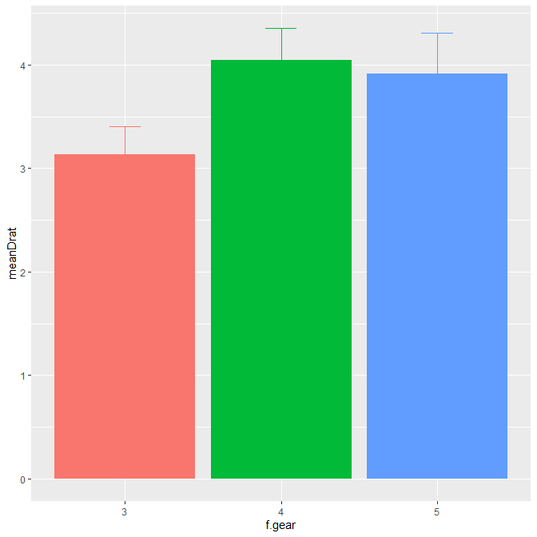
Error bars – to show variability or estimate significant difference
Plotting a barplot with error bars
e + geom_bar(stat="identity",show.legend=F) +
geom_errorbar(aes(ymin=meanDrat-sdDrat,ymax=meanDrat+sdDrat,colour=f.gear), width=0.2, show.legend=F) #Need to calculate our own error bars
Note: if you have barplots which are position=position_dodge(), then you also need to do the same for your error bars

Slide 4
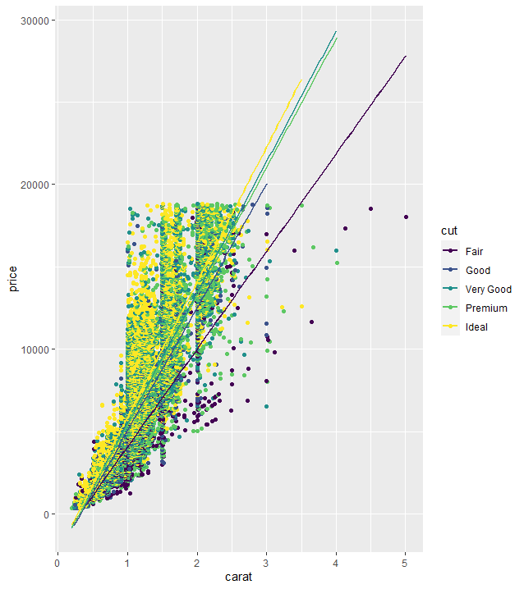
Trend lines – to show relationships
Linear relationship at 99% confidence level
f + geom_point() +
stat_smooth(method=lm, level=0.99)
Non-linear relationship at 90% confidence level
f + geom_point() +
stat_smooth(method=loess, level=0.9)
Linear with colours for groups without confidence levels
g + geom_point(aes(colour = cut)) +
stat_smooth(method=lm, aes(colour=cut),se=F)

Slide 5
Plotting aesthetics – changing colour, size and shapes of plot elements
Colours: http://sape.inf.usi.ch/quick-reference/ggplot2/colour
Point Shapes: http://www.sthda.com/english/wiki/ggplot2-point-shapes
Point Size: default is 1.5
Points: change colours, type, size
f + geom_point(color="red",fill="blue",shape=21,size=2)
Barplots: change colours, position
ggplot(mtcars, aes(x=f.cyl, fill=f.gear)) +
geom_bar(colour="black",position=position_dodge(width=0.8)) +
scale_fill_manual(values=c("#FF0000",hsv(0.3,1,0.8),rgb(0.1,0.2,1))) #Dodge for side-by-side, 3 different ways of specifying colour

Slide 6
Plotting aesthetics – adding text and shapes
Note: If you need to do this, I suggest you copy the figure to Powerpoint and do it there
f + geom_point() +
#Add text
geom_label(aes(x=5,y=3.5,label="This group is strange"),fontface="italic", colour="blue") +
geom_text(aes(x=2.5,y=4.7,label="Point of interest"),colour="red",size=5, fontface="bold",angle=45) +
#Add mathematical notation
annotate("text",x=2,y=3,label="R^2==0.76",parse=T) +
#Add point labels
geom_text(aes(label=rownames(mtcars)),vjust=-1,size=2.5) +
#Add a point
annotate("point",x=2.14,y=4.425,colour="red",size=3) +
#Add a rectangle
annotate("rect",xmin=5.2,xmax=5.5,ymin=2.9,ymax=3.25,alpha=0.2, colour="black",fill="blue") +
#Continued on next slide…

Slide 7
Plotting aesthetics – adding text and shapes
Note: If you need to do this, I suggest you copy the figure to Powerpoint and do it there
# ... continued from previous slide
#Add an arrow
annotate("segment",x=4.75,xend=5,y=3.4,yend=3.25,colour="blue",size=1, alpha=0.6,arrow=arrow()) +
#Add lines – Line types, see: http://www.sthda.com/english/wiki/ggplot2-line-types-how-to-change-line-types-of-a-graph-in-r-software
geom_vline(xintercept=4.2,colour="purple",size=3,linetype="longdash") +
geom_hline(yintercept=4.3,colour="pink",size=3,linetype="dotted") +
#Add a segment (essentially a fat line, also can be used to make slanted lines)
annotate("segment",x=3.5,xend=3.9,y=3.5,yend=3.75,colour="green",size=7, alpha=0.6) #alpha controls transparency

Slide 8
Plotting aesthetics – adjusting plot axes, labels, backgrounds and order
#Setting y-axis limits (for x-axis: xlim(min,max))
d + geom_boxplot() + ylim(0,7)
#Manually setting tick mark values
d + geom_boxplot() + scale_y_continuous(breaks=c(3,3.1,3.2,3.3,seq(3.4,4.5,0.1)))
#Removing and formatting tick text (both axes: axis.text)
d + geom_boxplot() + theme(axis.text.y=element_blank())
d + geom_boxplot() + theme(axis.text.x=element_text(angle=45, face="bold", size=18, vjust=1, hjust=1)) #vjust and hjust to set position
#Removing ticks
d + geom_boxplot() + theme(axis.ticks.y=element_blank())
#Removing ticks and text from y-axis
d + geom_boxplot() + scale_y_continuous(breaks=NULL)

Slide 9
Plotting aesthetics – adjusting plot axes, labels, backgrounds and order
#Specifying, removing and formatting axis labels
d + geom_boxplot() + xlab("My new x-axis label") + ylab("My new y-axis label \n(with this text in brackets on a second line")
d + geom_boxplot() + theme(axis.title.x=element_blank())
d + geom_boxplot() + theme(axis.title.y=element_text(angle=0, face="italic", size=8, colour="red", vjust=0.5)) #vjust usually from 0 (bottom) to 1 (top) but can be negative
#Changing panel settings: major/minor grid lines, background & border
d + geom_boxplot() +
theme(panel.grid.major = element_line(colour="red"),
panel.grid.minor = element_line(colour="red", linetype="dashed", size=0.2),
panel.background = element_rect(fill="lightblue"),
panel.border = element_rect(colour="blue", fill=NA, size=2))
#Changing Themes
d + geom_boxplot() + theme_bw()
d + geom_boxplot() + theme_bw() + theme(panel.border= element_blank(), axis.line=element_line(colour="black")) #removes the box around the plot and puts the axes back
d + geom_boxplot() + theme_classic()

Slide 10
Plotting aesthetics – adjusting plot axes, labels, backgrounds and order
#Legend: changing the title
d + geom_boxplot(aes(colour=f.cyl)) + labs(fill="My Legend Title")
#Legends: changing the appearance
d + geom_boxplot(aes(colour=f.cyl)) + theme(
legend.background = element_rect(fill="grey85", colour="red", size=1),
legend.title = element_text(colour="blue", face="bold", size=14),
legend.text = element_text(colour="red"),
legend.key = element_rect(colour="blue", size=0.25) +
+ labs(fill="My Legend Title"))
#Moving and removing the legend
d + geom_boxplot(aes(colour=f.cyl)) + theme(legend.position ="none") #try "top", "bottom", "left", "right“
d + geom_boxplot(aes(colour=f.cyl)) + theme(legend.position =c(0,0), legend.justification=c(0,0)) #legend.position/legend.justification – first number: 0 = left, 0.5 centre, 1 = right; second number: 0 = top, 0.5 middle, 1 = bottom. Try playing with the numbers

Slide 11
Plotting aesthetics – adjusting plot axes, labels, backgrounds and order
#Legends: change title formatting
d + geom_boxplot(aes(colour=f.cyl)) + labs(fill="My Legend Title")
d + geom_boxplot(aes(colour=f.cyl)) + theme(
legend.background = element_rect(fill="grey85", colour="red", size=1),
legend.title = element_text(colour="blue", face="bold", size=14),
legend.text = element_text(colour="red"),
legend.key = element_rect(colour="blue", size=0.25) +
labs(fill="My Legend Title"))
#Moving and removing the legend
d + geom_boxplot(aes(colour=f.cyl)) + theme(legend.position ="none") #try "top", "bottom", "left", "right“
d + geom_boxplot(aes(colour=f.cyl)) + theme(legend.position =c(0,0), legend.justification=c(0,0)) #legend.position/legend.justification – first number: 0 = left, 0.5 centre, 1 = right; second number: 0 = top, 0.5 middle, 1 = bottom. Try playing with the numbers
#Swapping x- and y-axes
d + geom_boxplot() + coord_flip()

Slide 12
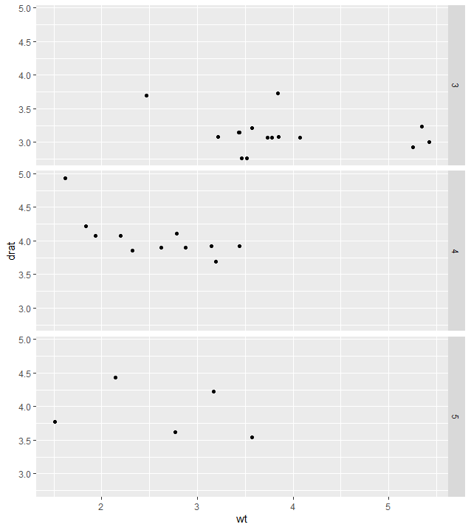
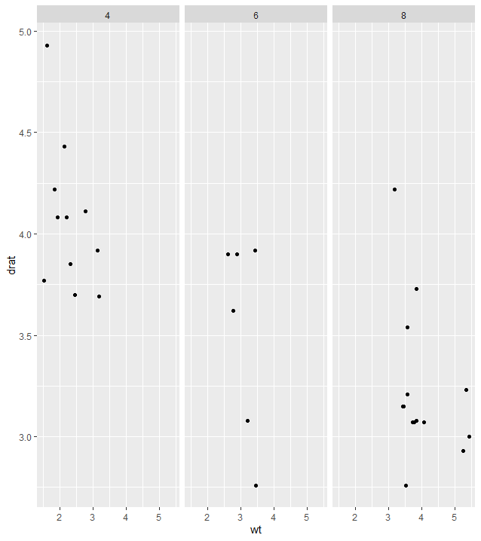
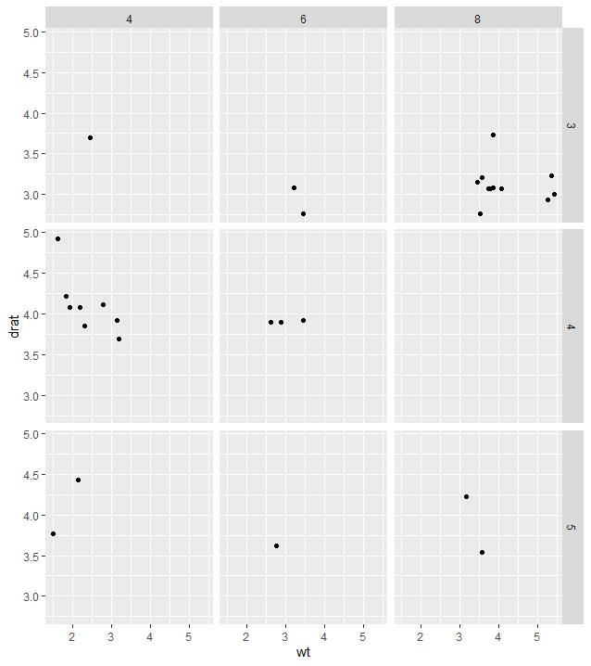
Plotting aesthetics – multiple plots
#Putting the same variables for different subgroups on different subplots
#Split data by f.gear vertically
f + geom_point() + facet_grid(f.gear ~ .)
#Split data by f.cyl horizontally
f + geom_point() + facet_grid(. ~ f.cyl)
#Both at the same time
f + geom_point() + facet_grid(f.gear ~ f.cyl, labeller = label_both)
#Fill up a grid with graphs of the different levels of carb, right to left then top to bottom
f + geom_point() + facet_wrap(~carb)

Slide 13
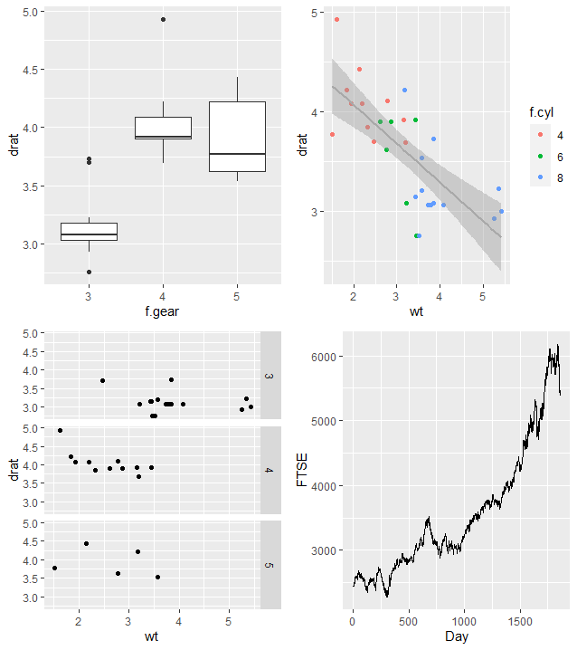
Plotting aesthetics – multiple plots
#Putting plots with different variables on different subplots
require(grid)
require(gridExtra)
#Create the plots first
plot1=d+geom_boxplot()
plot2=f+geom_point(aes(colour= f.cyl))+stat_smooth(method=lm, colour="darkgrey")
plot3=f+geom_point()+ facet_grid(f.gear~.)
plot4=h+geom_line()
#Map it onto the grid: left to right, then top to bottom
grid.arrange(plot1,plot2,plot3,plot4,ncol=2)
Note: If you need to do this, I suggest you copy the figures to Powerpoint and do it there

Slide 14
Further information on ggplot2
Documentation:
- http://docs.ggplot2.org/current/
- http://r-statistics.co/Top50-Ggplot2-Visualizations-MasterList-R-Code.html
Google!

